Slide 1
Operation Analytics and Investigating Metric Spike Advanced SQL
BY LAVANYA B

Slide 2
Project Description
Operational Analytics is a crucial process that involves analyzing a company's end-to-end operations. This analysis helps identify areas for improvement within the company. As a Lead Data Analyst, I worked closely with various teams such as operations, support, and marketing to derive valuable insights from the data collected.
One of the key aspects of Operational Analytics is investigating metric spikes, which involves understanding and explaining sudden changes in key performance indicators. This project consists of two case studies that focus on job data analysis and user engagement trends.

Slide 3
Approach
To carry out this project, I followed a structured data analysis process:
Importing Data - imported large file size CSV file to MySql by a query with the help for demo video which attached with given files.
Understanding the Data – I examined the datasets provided for both case studies to understand their structure and key attributes.
Query Execution – I wrote SQL queries to extract relevant insights from the datasets.
Analysis & Interpretation – I analyzed the query results to extract data according to the given task.
Reporting & Documentation – I compiled my findings into a structured format, capturing key insights from each analysis.

Slide 4
Tech-Stack Used
For this project, I utilized the following tools:
MySQL Workbench – Used for writing and executing SQL queries, retrieving insights, and managing database operations.
Google Slides/PowerPoint – Used to compile the report and present the analysis effectively.

Slide 5
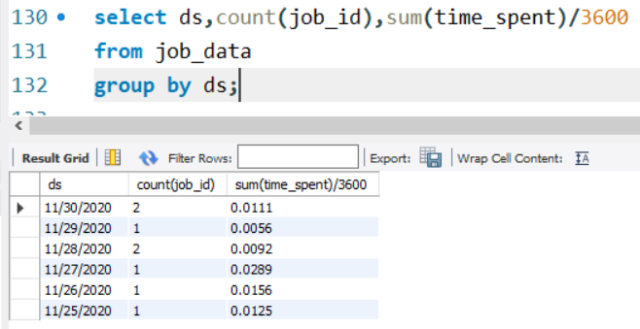
Case Study 1: Job Data Analysis
Tasks A : Jobs Reviewed Over Time
Analyzing trends in job reviews to identify fluctuations.
Calculated the number of jobs reviewed per hour for each day in November 2020.
As the given Time spent to review the job are in seconds.
So the time converted to hours by dividing 3600.
Calculated number of jobs reviewed each day per hour is attached here.
There are 2 jobs were reviewed on 30th nov 2020 and 28th nov 2020 each.
Rest all days, 1 job was reviewed.

Slide 6
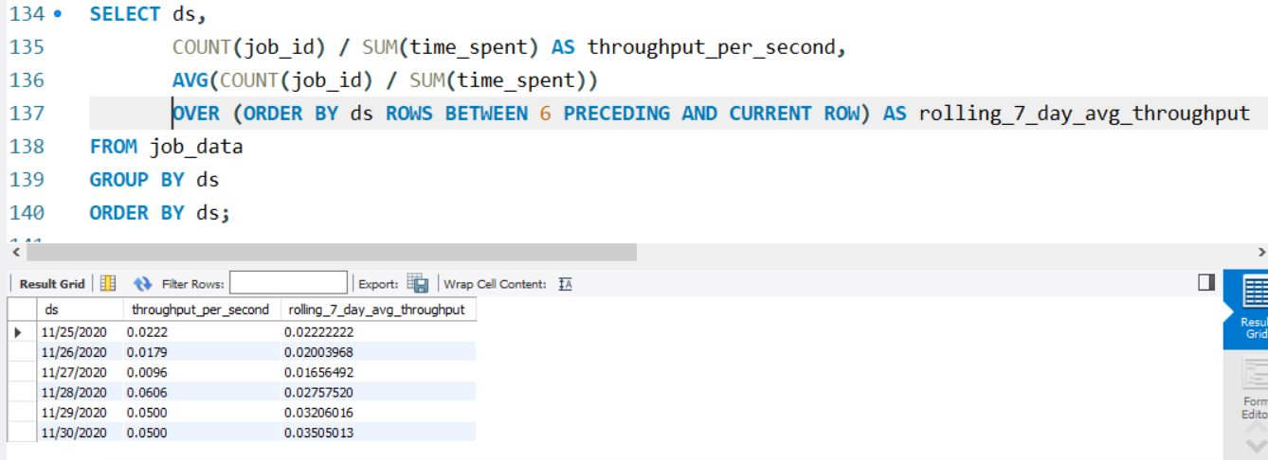
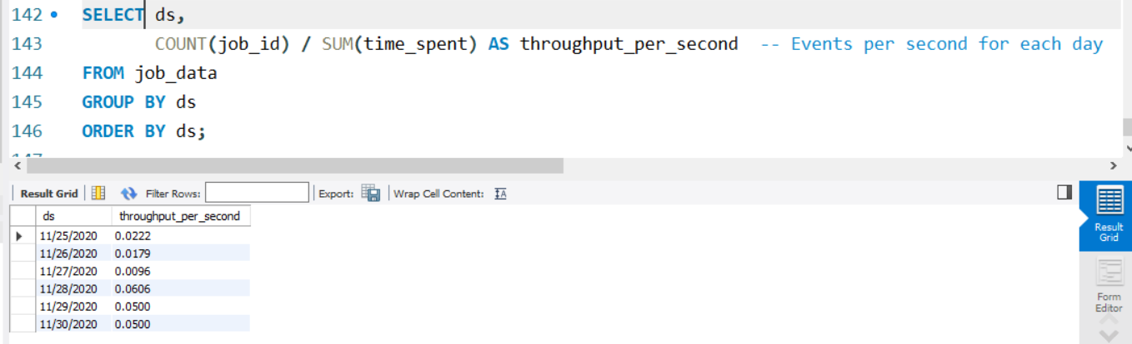
Task B : Throughput Analysis:
Calculate the 7-day rolling average of throughput (number of events per second).
Here I attached both daily metric and the 7-day rolling average for throughput.
In the given data, there were only 6 days data only there, so I preferred to do daily metrics. And 7-day rolling metric was new to me so I researched how to do in internet and have calculated.

Slide 7
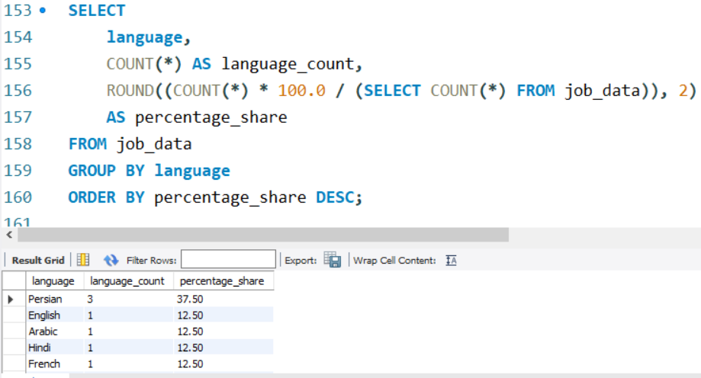
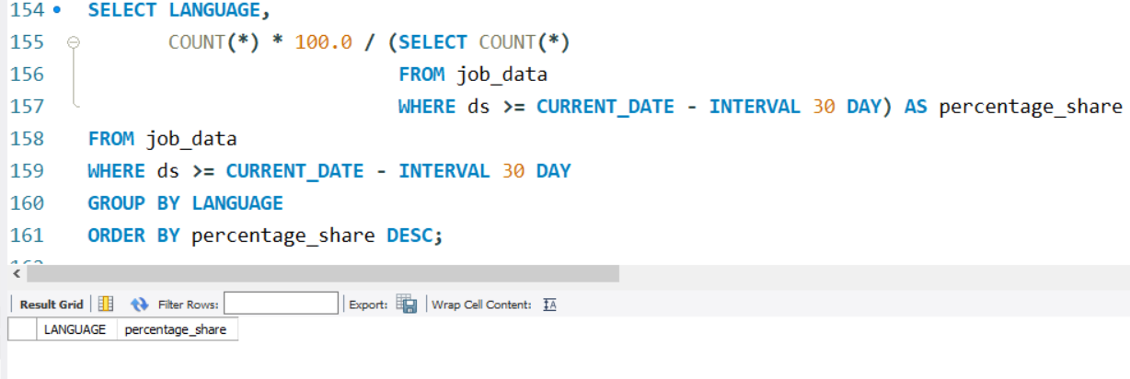
Task C: Language Share Analysis:
Calculated the percentage share of each
language based on all 6 days of data instead
of a 30-day period. As the given data have
only 6 days of data. And also I tried to calculate by doing some research, but no entries were given as output when I tried to calculate for over 30 days.
PERSIAN language have more percentage share than all other languages.

Slide 8
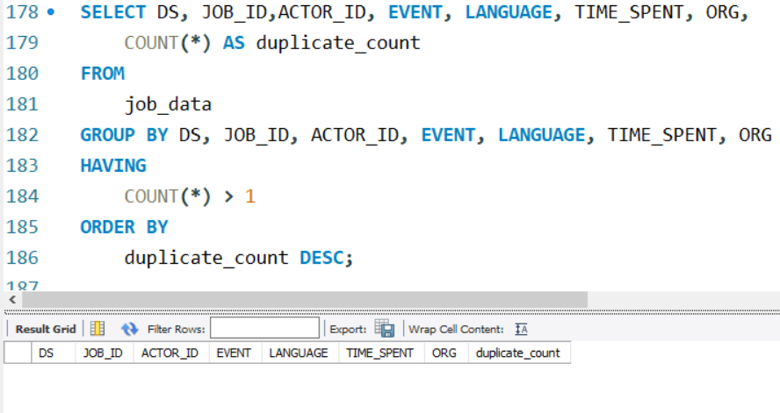
Task D : Duplicate Rows Detection:
There were no duplicate rows from the job_data table.
As the table have 8 rows which having unique values and has no duplicate rows or data in that table.
The output comes with zero entries.

Slide 9
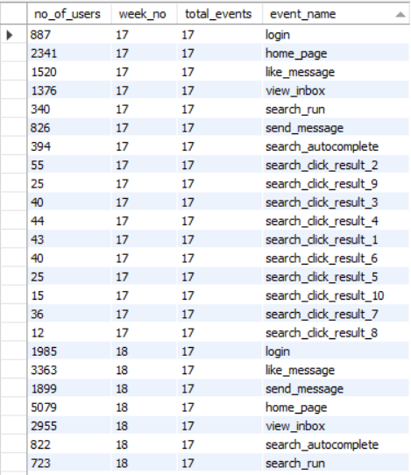
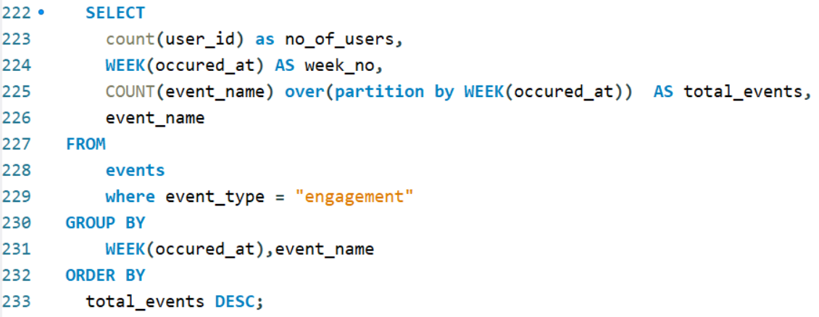
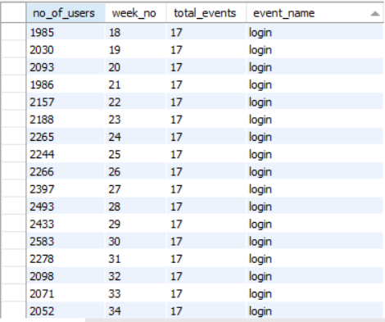
Case Study 2: Investigating Metric Spike Task A : Weekly User Engagement:
Result type 1
Calculated the weekly user engagement.
There are two ways that I calculated for this question.
Result type 1
Output 1 - The result of specific week user engagement for each event name. eg-17th week.
Output 2 – results of user engagement for single event. Eg. Login event. Each week by week , I got number of users who engaged on the Login event.
Result 2

Slide 10
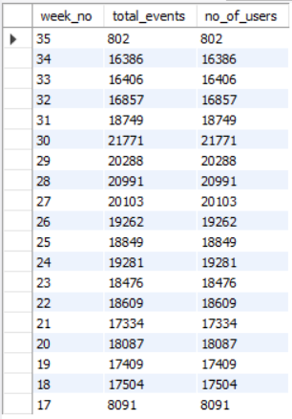
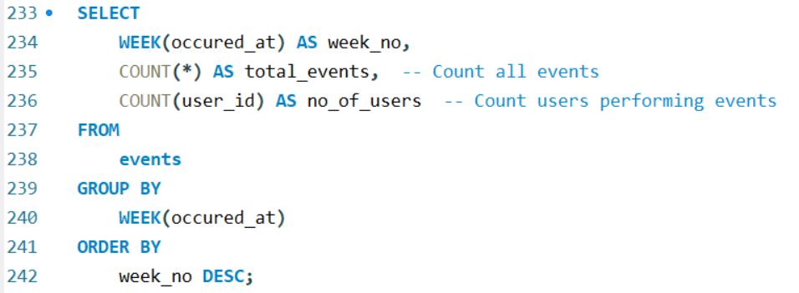
Task A : Weekly User Engagement:
Result type 2
Calculated the weekly user engagement.
There are two ways that I calculated for this question.
Result type 2
This result shows the total number of users and the total number of events they engaged with each week for all event types.

Slide 11
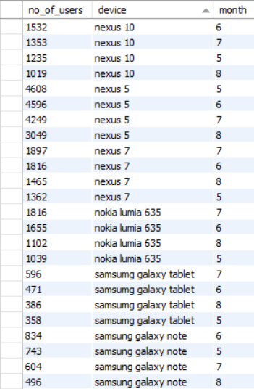
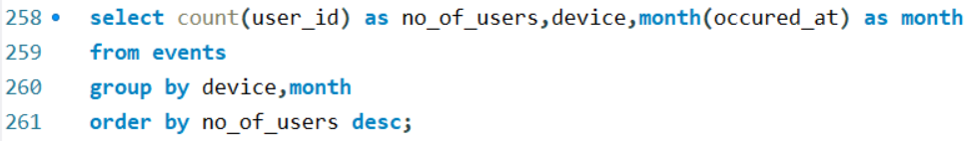
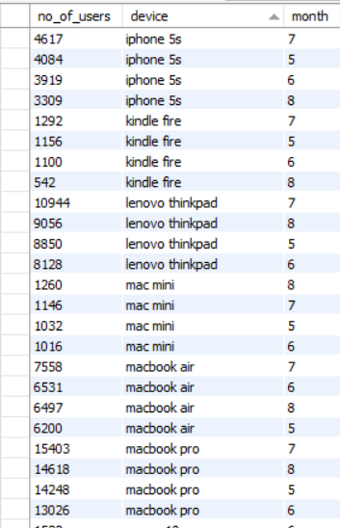
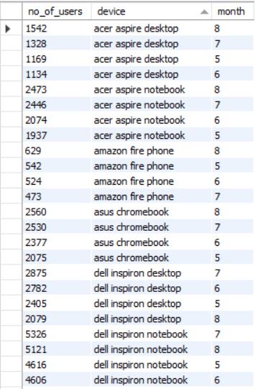
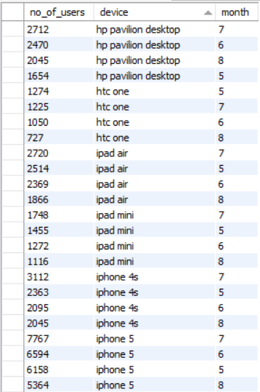
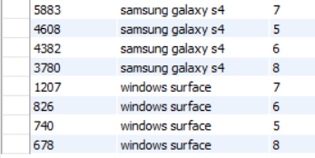
Task B: User Growth Analysis
Result 1
Result 2
Calculated the number of users engaged with each devices in each respective month. There are 4 months , each month I extracted number of users for each product.

Slide 12
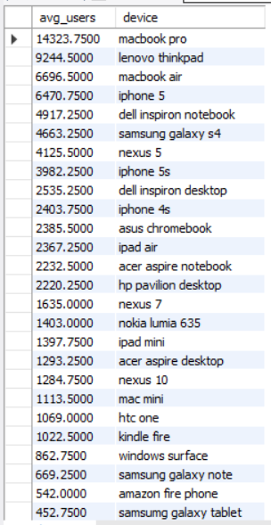
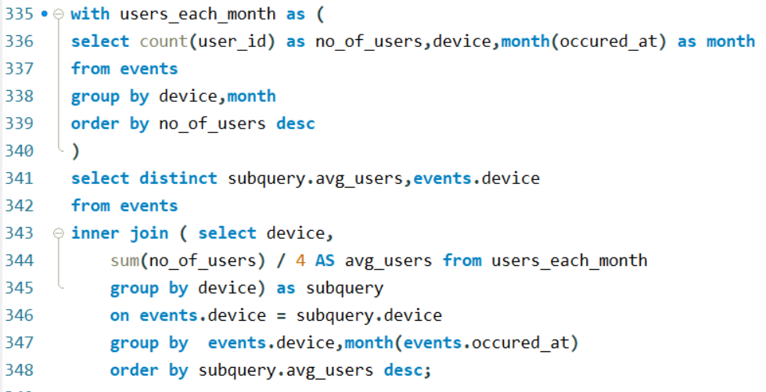
Task B: User Growth Analysis
Result 2
In this result 2, I derived average number of users growth per device. Here I calculated sum of users and divided by 4 that is total number of months. That gives the total average number of users who used the particular device. From this we can analyze which all the devices have more user growth.

Slide 13
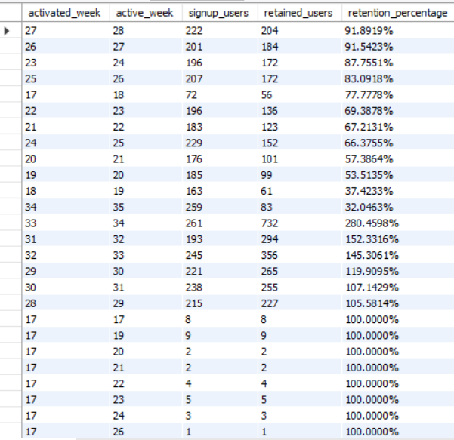
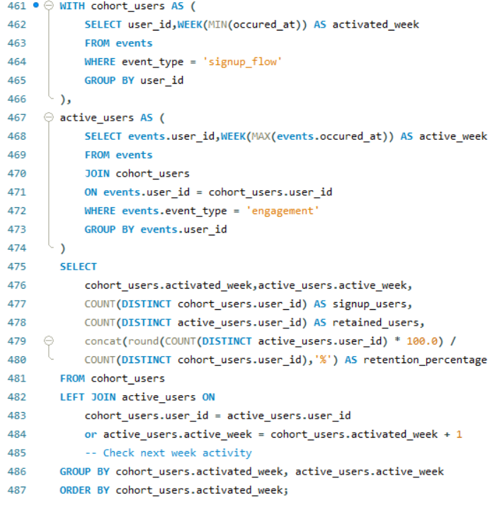
Task C: Weekly Retention Analysis
Calculated the weekly retention of users based on their sign-up cohort.
Activated - The users sign up for the product
Active week – the last week where that users active.
Extracted only sign-up users and calculated the total sign-ups per week. Identified the last active week for each user, determined retained users for each specific week, and finally calculated the retention percentage.

Slide 14
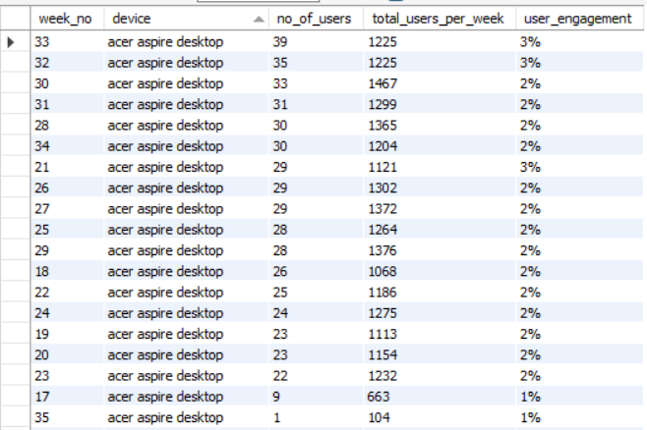
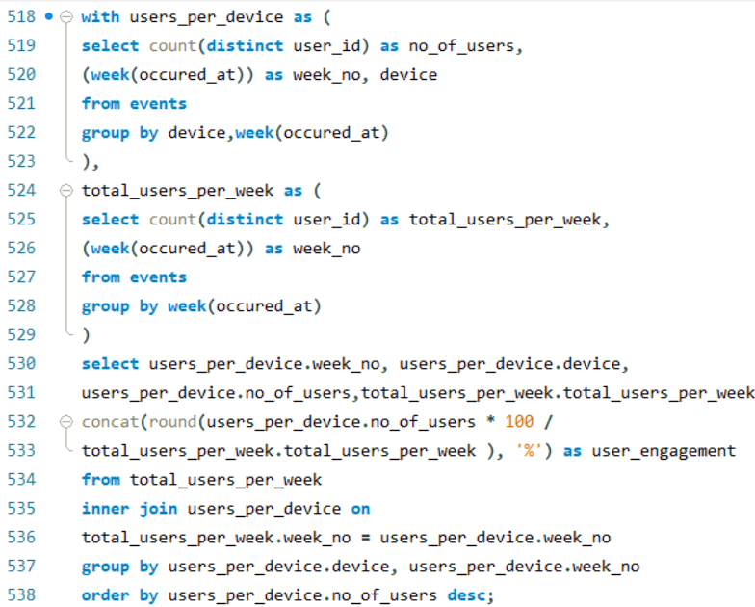
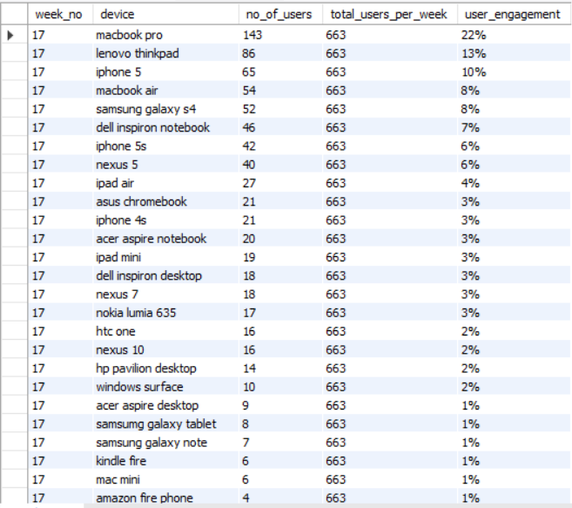
Task D: Weekly Engagement Per Device
Output
1
Calculated the weekly engagement per device.
Output 1: Eg.’acer aspire desktop’ device engagement by weekly basis. From Total no.of users per week, I calculated number of users engaged with this particular device. From this I calculated percentage of user engagement.
Output
2
Output 2: result of user engagement per week. Eg: 17th week, I calculated total number od users engaged on 17th week, then calculated number of users engaged on each device, and its user engagement percentage. 663 users engaged in 17th week, from that ‘mackbook pro’ device has 143 users engaged. 22% user engagement for mackbook pro device.

Slide 15
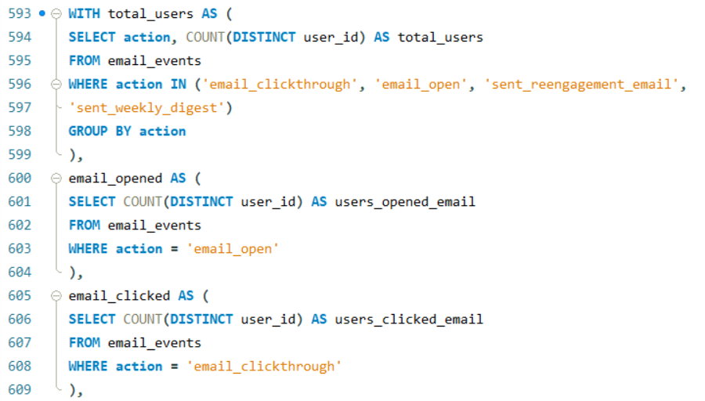
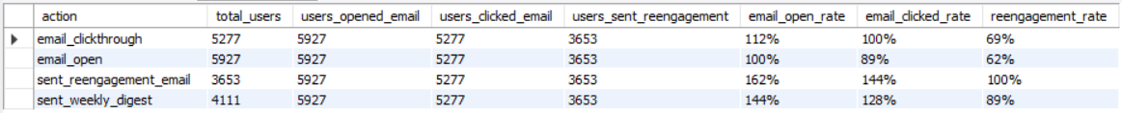
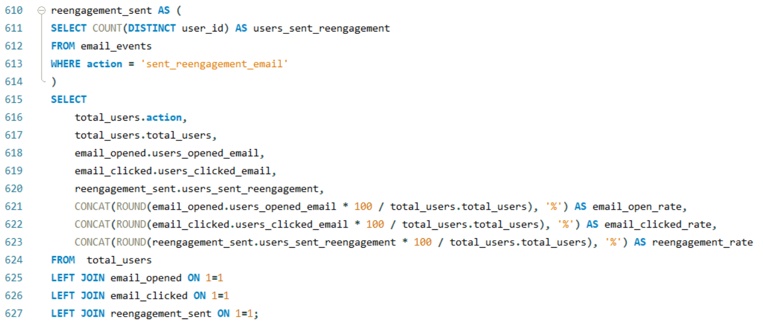
Task E: Email Engagement Analysis
Calculated the email engagement metrics by this long CTE.
There are 4 actions. For each action, I calculated total number of unique users. From that calculated number of users opened email, users clicked email,users sent reengagement. From that number of users for each category, I calculated percentage metrices of each category by
dividing the total number of users
for each action.

Slide 16
Insights Through this project, I gained valuable insights into:
Jobs Reviewed Over Time – Identified trends in job reviews, Calculated the number of jobs reviewed per hour for each day.
Throughput Analysis – Measured job completion rates, helping optimize workflow..
Language Share Analysis – Analyzed language distribution in job postings, aiding in resource allocation and market targeting.
Weekly User Engagement – Observed fluctuations in user interactions, helping refine engagement strategies.
User Growth Analysis – Tracked new user sign-ups, highlighting growth trends and retention challenges.
Weekly Retention Analysis – Determined the percentage of returning users, providing insights into user loyalty.
Weekly Engagement Per Device – Compared engagement across devices, optimizing user experience for different platforms.
Email Engagement Analysis – Evaluated the effectiveness of email campaigns, guiding improvements in communication strategies.

Slide 17
Result
This project provided hands-on experience in operational analytics, allowing me to:
Extract meaningful insights from real-world datasets.
Strengthen SQL skills by writing advanced queries to solve business problems.
Improve decision-making through data-driven insights.
Enhance report presentation skills for effective storytelling with data.

Slide 18
Drive Link
A detailed report with SQL queries, screenshots of outputs, and analysis is compiled in this PPT document.
The link to the MySQL Script document is given below.
https://drive.google.com/drive/folders/1ycSCOgHPkHqX4rI8VX_993xOPMbBn5fW?usp=sharing

Slide 19
Thank you for the opportunity to work on this project as a Lead Analyst . It has been a valuable experience in analyzing operational data and deriving meaningful insights. What I Learned: I gained hands-on experience in ADVANCED SQL, IMPORTING LARGE SIZE DATA and investigating METRIC SPIKES. This project enhanced my analytical thinking and improved my ability to interpret data-driven trends.
BY LAVANYA B

